Slide 1
Trebuchet Project
Group members: Jared Forbes, Tony Tufano, Andrew Toepfer, and Evan Spangler

Slide 2
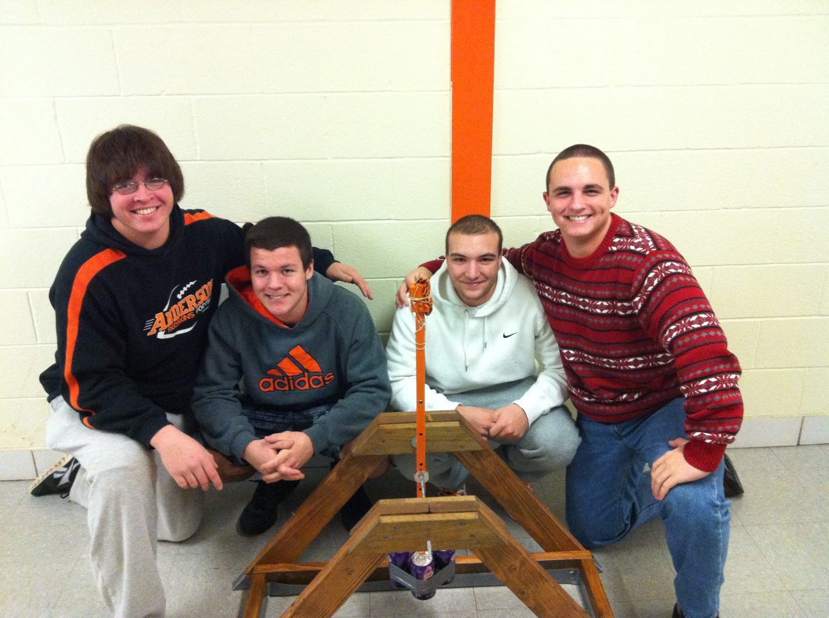
Group members

Slide 3
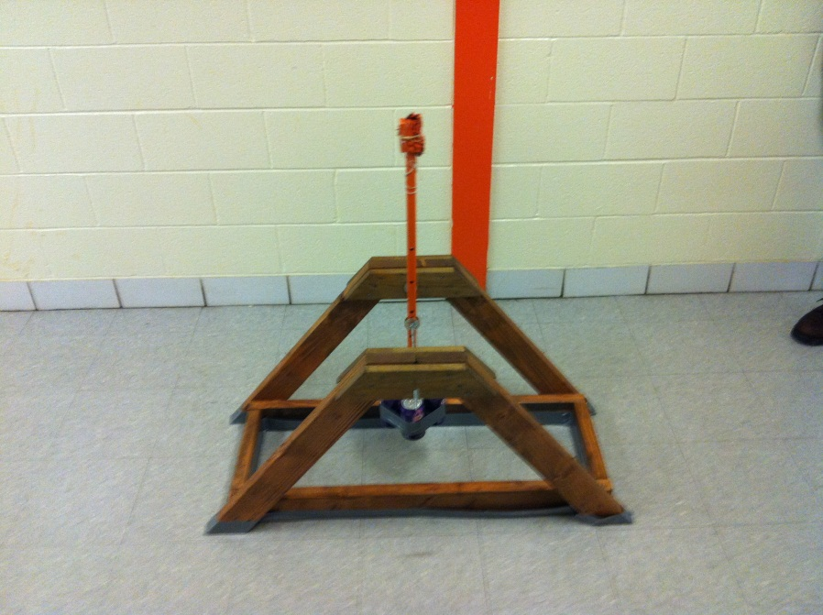
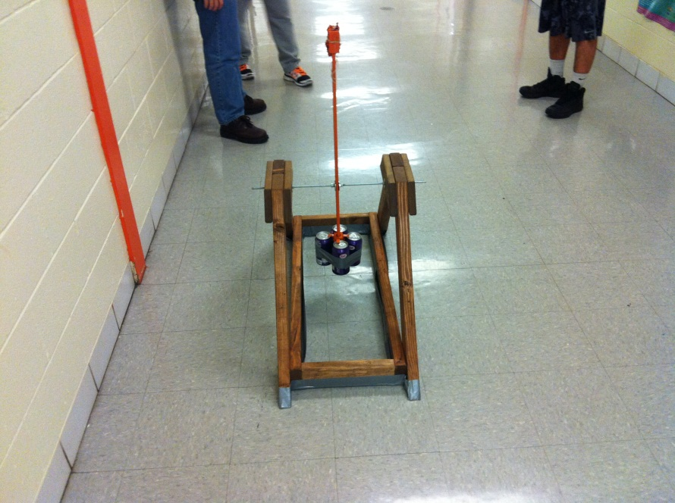
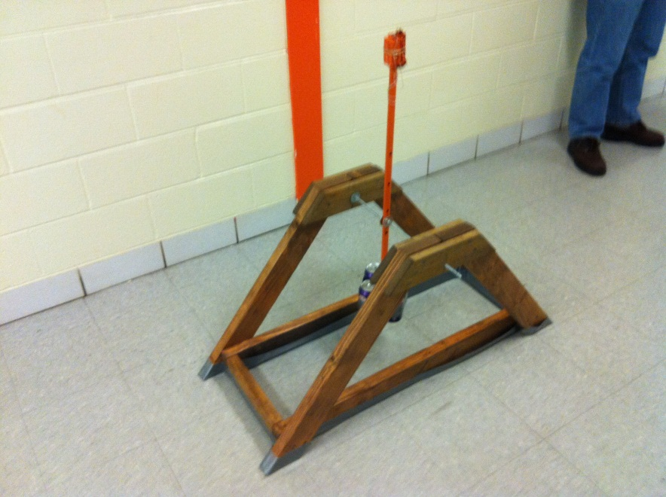
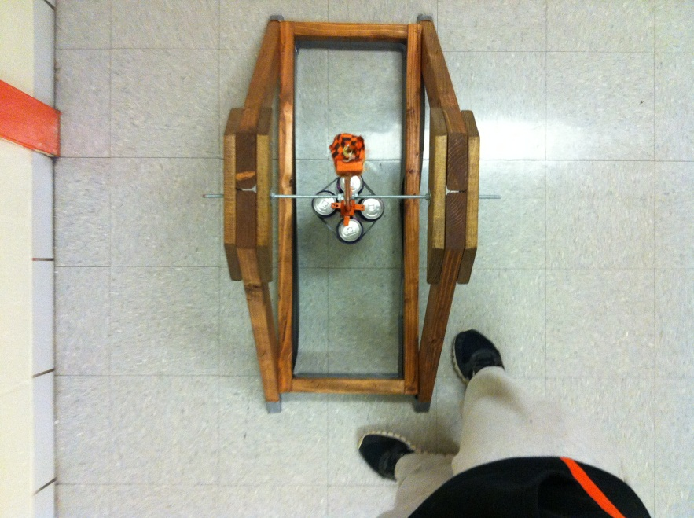
Trebuchet Pictures

Slide 4
Trebuchet Video

Slide 5
Trebuchet video part 2

Slide 6
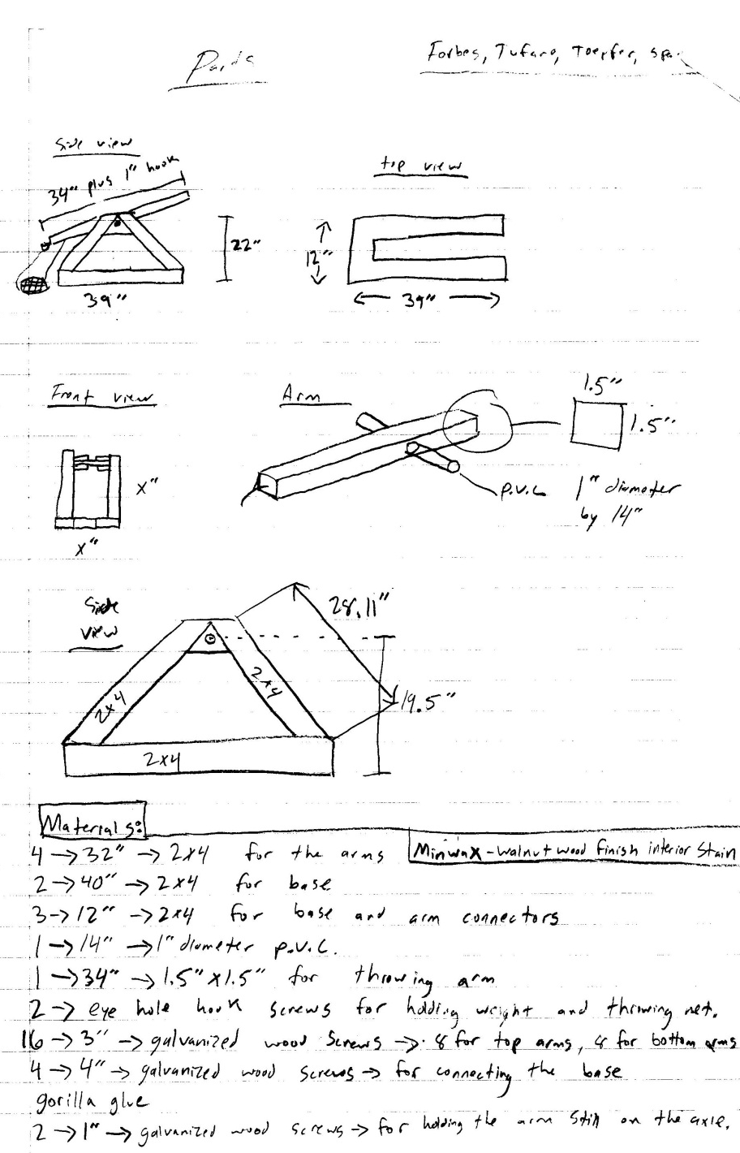
Original design

Slide 7
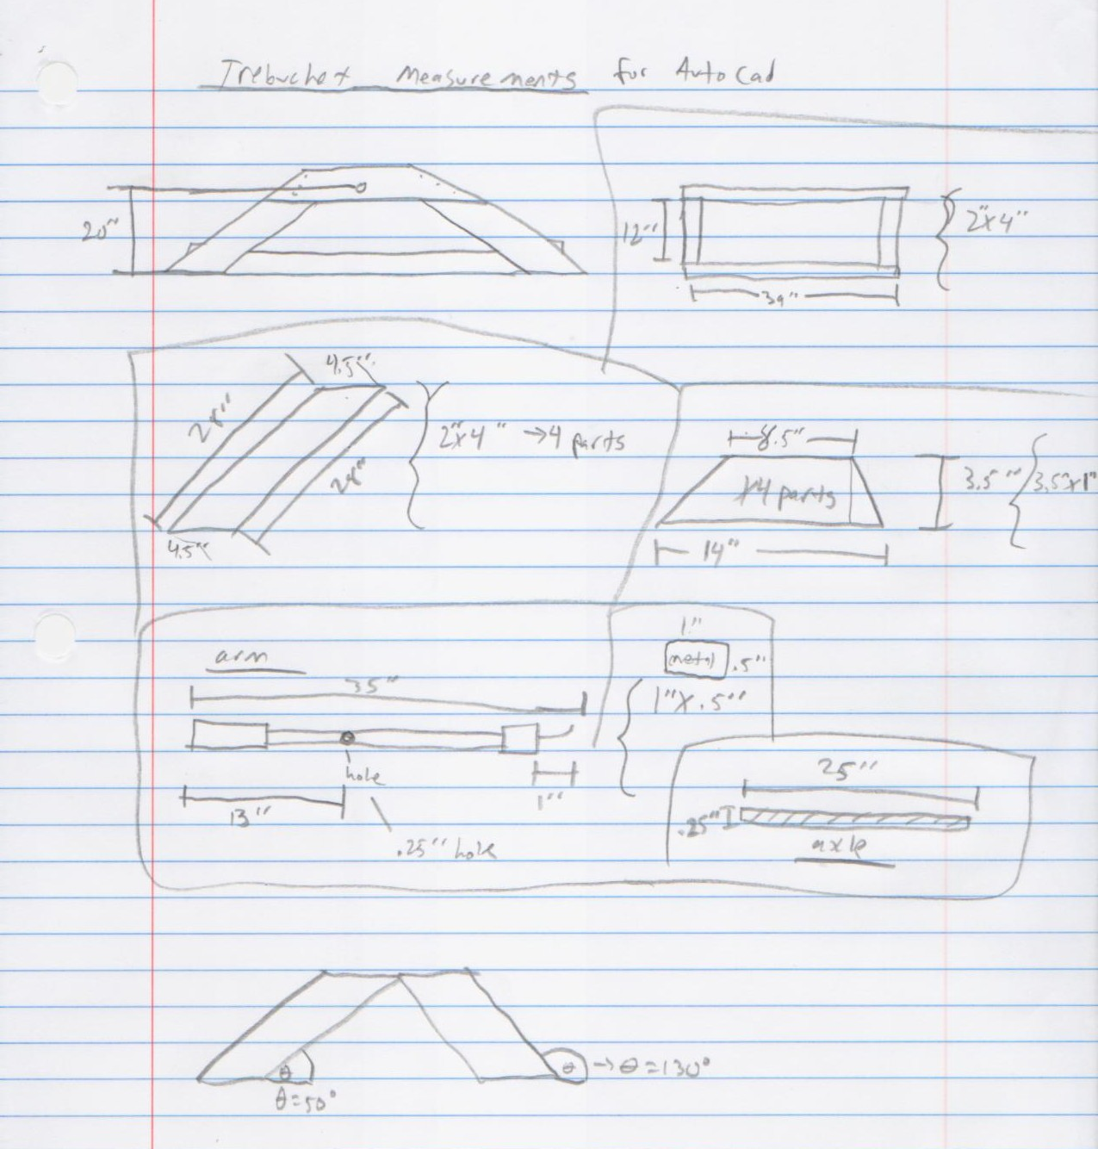
Modified design

Slide 8
Materials list
34 screws
2 X 39’’ 2 by 4’s
2 X 12’’ 2 by 4’s
4 X 28’’ angle cuts 2 by 4’s
4 X 12’’ angle cuts 1 by 4’s
A 22’’ by .25’’ thick axle rod
10 nuts
6 washers
2 wood blocks
1 nail
42’’ string
8 X 90 degree angle brackets

Slide 9
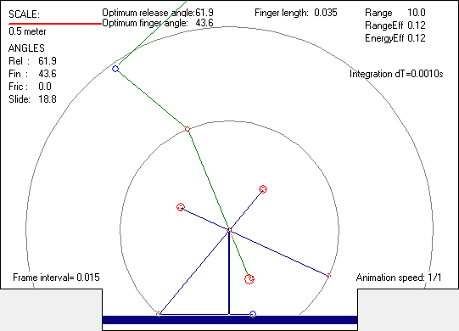
Atreb data: graph

Slide 10
Atreb data: INPUT DATA
Mass of the counterweight.....M1=1.64 kg
Mass of the missile...........M2=0.03 kg
Mass of the main arm..........M3=0.35 kg
Mass of the CW link...........M4=0.50 kg
Mass of the sling pouch.......M5=0.10 kg
Mass of the finger assy.......M6=0.00 kg
Mass of the Pivot1 assy.......M7=0.00 kg
Short arm length..............L1=0.28 m
Long arm length..............L2=0.59 m
Sling length..................L3=0.50 m
CW Link length................L4=0.00 m
Main arm support..............L5=0.45 m
Sling mass....................0.000 kg
Sling thickness...............0.0010 m
Analysis mode:................ADVANCED
Aerodynamics:.................OFF
Friction:.....................OFF
Throwing arm:.................BASIC
Friction in pivot P1:.........N/A
Diameter of pivot P1:.........N/A
Friction in pivot P3:.........N/A
Diameter of pivot P3:.........N/A
Arm width at pivot P1:........0.018 m
Arm width at pivot P2:........0.018 m
Arm width at pivot P3:........0.018 m
Arm height at pivot P1:.......0.037 m
Arm height at pivot P2:.......0.037 m
Arm height at pivot P3:.......0.037 m
Arm density...................600.0 kg/m3
Missile Density...............1500.0 kg/m3

Slide 11
Atreb data: RESULTS OF ANALYSIS
Release angle:................61.9 deg
Finger angle:.................43.6 deg
Slide angle:..................18.8 deg
Friction angle:...............0.0 deg
Max. missile acceleration:....37.8 m/s2
Missile velocity at launch:...9.6 m/s
Trajectory angle (initial):...43.2 deg
Max. tension in the sling:.... 17.8 N
Max. angle of CW:.............195.7 deg
Min. angle of CW:.............-500.7 deg
Max. load in pivot P1:........ 359.5 N
Max.angular vel. of arm:......390.5 deg/s
Max.angular acc. of arm:......25803.8 deg/s2
Max. load in pivot P3:........ 358.3 N
Max. bending moment:.......... 17.1 Nm
Min. bending moment:.......... -24.4 Nm
Max. stress in arm:........... 4.2 MPa
Min. stress in arm:........... -6.0 MPa
Max. transv.load on finger:... 8.9 N
Finger length:................0.04 m
Time of release:..............0.54 s
Flight time (missile):........2.06 s
Range of the throw:...........10.0 m
Range efficiency:.............0.123
Energy efficiency.............0.123
Initial potential energy:..... 10.5 Nm

Slide 12
Atreb data: ADDITIONAL INFORMATION
Mass of the arm adjusted:.....NO
Release angle optimized:......YES
Additional Sections used......NO
Rotating CW...................YES
Finger length by..............ATreb
Mass of the finger ring:......0.001 kg
Analysis time step:...........0.001 s
CW propped....................NO
CW prop angle.................N/A
Constraints of arm/CW.........N/A

Slide 13
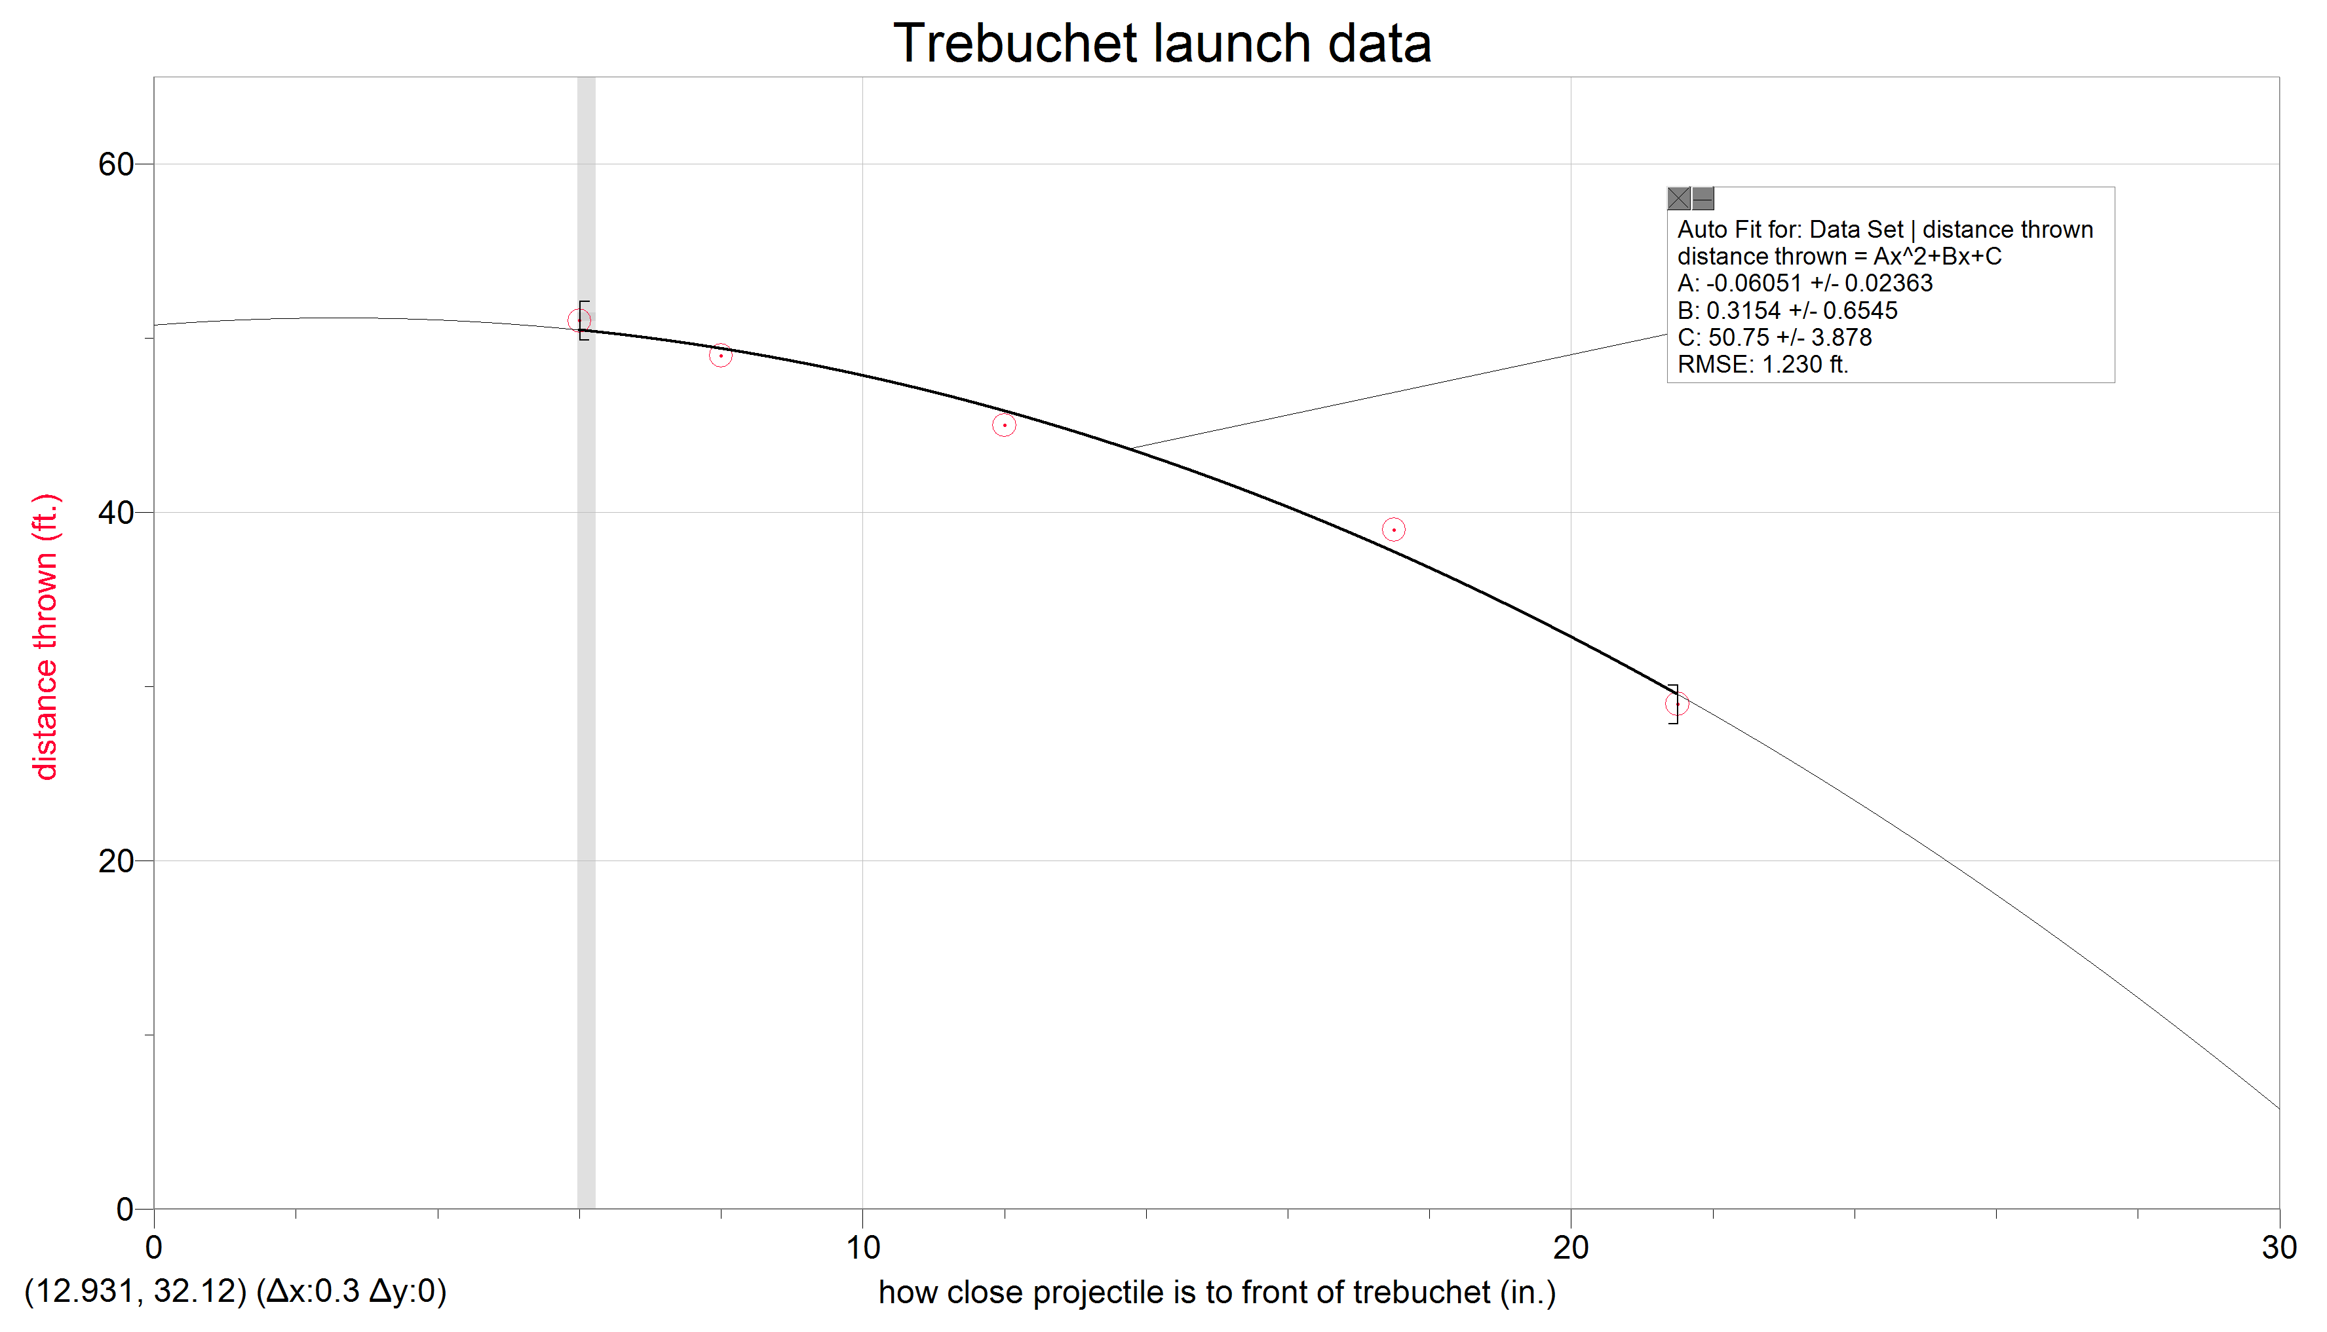
Graph of Launch data

Slide 14
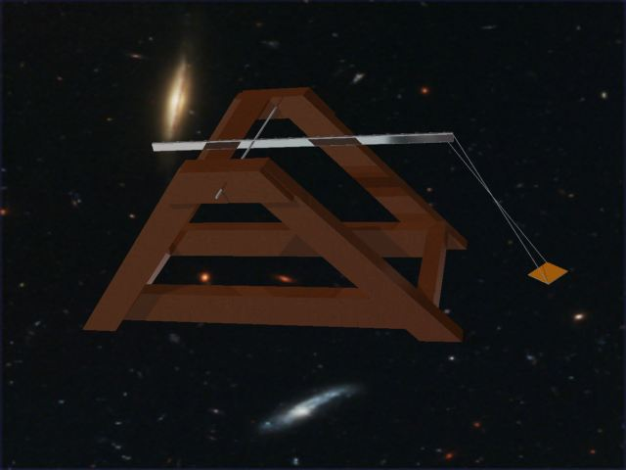
Autocad: Rendered Image

Slide 15
Autocad: disassembly video

Slide 16
AUTOcad:video

Slide 17
Building summary
When we first started this project our preconceived perception of trebuchets were very simple, a base, an arm, weight, and a projectile. Although after we started digging into the project we learned very quickly that trebuchets take a lot of time to make, and are also very precise machines. Our first challenge was building the base. We needed to know how long to make it so that the ball wouldn’t hit it on its launch course. Also, we needed to construct the base in way that it would be stable when firing (so energy would not be lost). After that, we moved onto the arm. This was probably the most difficult part of the project. We relied on Atreb heavily for this portion. We had no idea what length the long and short arm should have been. Once we overcame that challenge we moved on to the drilling. This was challenging, because we had to drill the holes perfectly in line with one another or else the axle would be bent. We overcame this by using a pilot rod after we drilled our first hole. There are also some areas in our trebuchet that have room for improvement. One main one was the sling length. This is because of the way we constructed our base. We made our sling based on the constrictions of our base. If we would have had an open base, we would have been able to maximize the length. The other part of our trebuchet that needed improvement was our base. We weren’t able to make it stable (meaning it had a wobble to it). We managed this problem by adding duct tape to it. These are the trials and tribulations that we faced while we constructed our trebuchet.

Slide 18
Test Results
After we put in our data to Atreb it gave us values for our range and our launch angle. The software said that our trebuchet’s range would be 10 yards. Although after testing out our trebuchet, we found that it threw in the 51 feet range, far exceeding the prediction made by the Atreb program. Upon further inspection, we also found that the launch angle that it gave us was off too. It said that our angle should be roughly 61.9 degrees, although when we froze the trebuchet right before firing, we found that the angle looked much smaller than 61.9. It looked more along the lines of 45-50 degrees. This is probably why our distance was off as well. The values could have also been off due to our sling (we couldn’t make it to the Atreb specs). Even so, our trebuchet’s data differed greatly from what Atreb said it would be, and that’s probably for the better.

