Slide 1
PVC Modified Nerf Gun
JARED FORBES AND TONY TUFANO

Slide 2
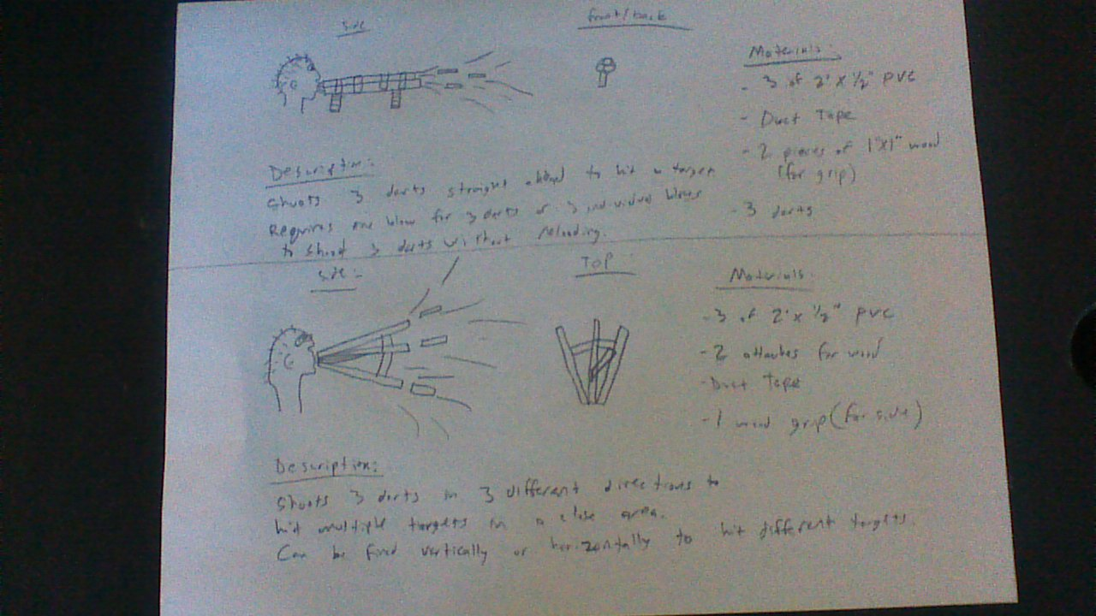
Sketches

Slide 3
Final Design

Slide 4
Final Design

Slide 5
Description
The Nerf gun is two PVC pipes that are powered by blowing into it with separate shots.
The Flashlight provides light in a dark room or if in a light room is can create a blinding effect
The grip increases stability

Slide 6
Materials
6 feet of ½ inch PVC pipe
Duct Tape
Flashlight
Grip
Nerf shells
Nerf Darts

Slide 7
Data
Trial | Distance Traveled | Wind | Time
1 | 51.3 ft | 1.5 mph | 2.9 seconds
2 | 45.6 ft | 2.20 mph | 3.1 seconds
3 | 53.6 | 0.95 mph | 2.6 seconds
The darts used weighed one gram with a airsoft pellet in the tip of the dart. The pellet was used to stop the wobbling of the dart.
The gun itself weighs 1814.4 g or 1.8 kg.

Slide 8
Results
When it came to testing the gun for distance it performed exceptionally well. With little to no wind interrupting the projection of the dart, it shot extremely far for how much blow force was used. When we tested how high the dart shot, the average time it took to come down after being shot was about 2.8667 seconds. This data is considering that the mean wind speed was 1.55 miles per hour. The wind speed was tested using an anemometer that really came in handy for additional data. The darts accuracy was even better! With the addition of the airsoft pellet inside the tip of the dart, it allowed the dart to shoot straighter and without wobble.

Slide 9
Overview of Project
The project overall was simple but we ran into a few problems. The Sunday before the project was due is when Jared’s tank exploded and shattered everywhere causing minor cuts to legs. Tony’s tank decided to leak and not allow enough pressure to shoot the dart very far. This is why we had to come up with an immediate replacement project so we constructed a 3 piece pipe blow gun out of PVC. The picture of the exploded tank can be found on the next slide.

Slide 10
Shattered Tank
The picture shown is the result of to much pressure applied to PVC. We pumped the tank up using a compressor and put to much air in it. A few seconds later a loud explosion occurred and our piece of art was destroyed in a blink of an eye. Our hearts, just like the tank, were shattered into a million pieces as we watched our project, that we put many hours in, be destroyed.

