Slide 1
Dance Pad Mania
By: Jared Forbes

Slide 2
Understand
Build a ¼ scale (11x17 inches) dance pad where students can step on six individual buttons to flash a light according to specifications.
Parts: 6V batttery, Aluminum foil, four light bulbs, duct tape, electrical wire, plastic wrap, scissors, wire strippers.

Slide 3
PHET LAB

Slide 4
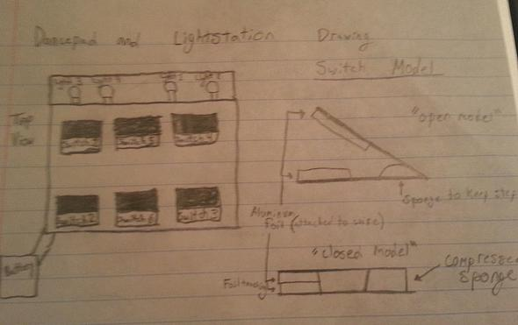
Brainstorming and prototypes
This brainstorming sketch is where we got ideas such as the 11 x 17 inch layout, and the way the switch would work

Slide 5
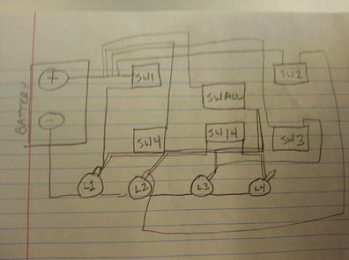
Refinements
This schematic diagram shows how we decided to wire the dance pad to the battery and light station.

Slide 6
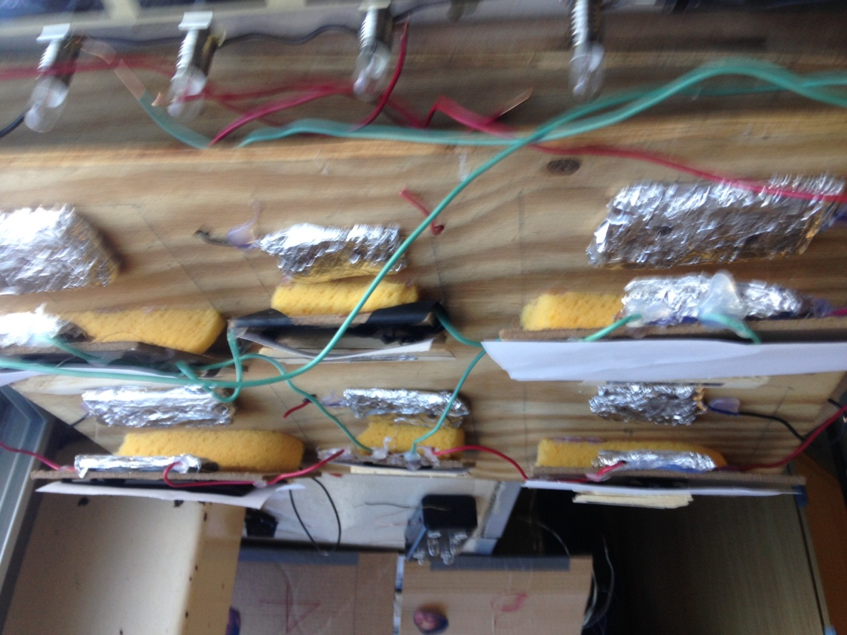
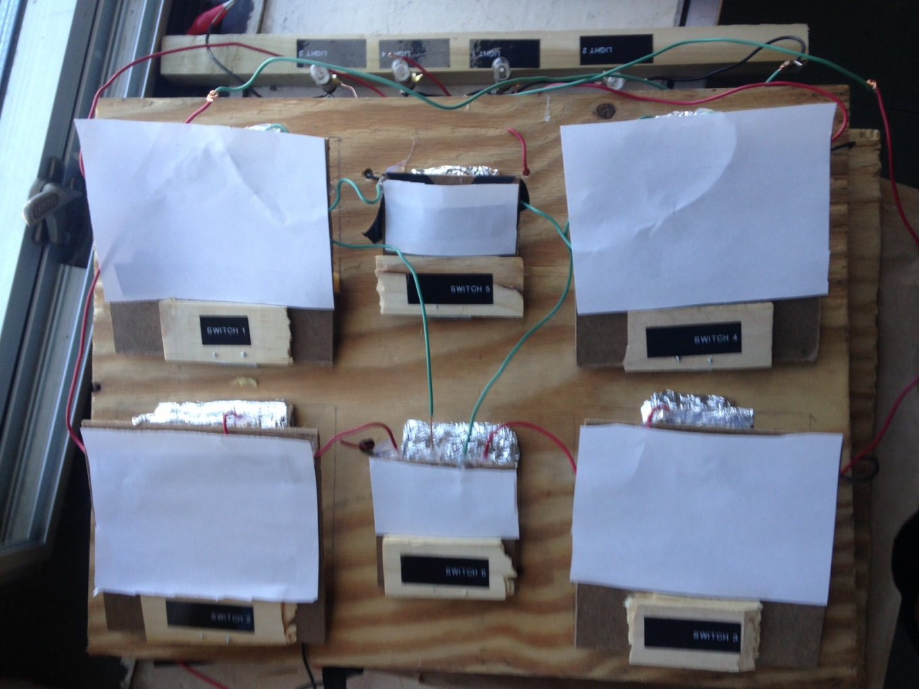
Final Product

Slide 7
How It works
The dance pad works by hooking up the positive wires to the light stand and the negative to a battery. You then hook up the light stand wires to the battery as well. When this is done when you press on one of the button it lights up one, two, or all four lights depending on the button. The circuit is not complete unless button is pressed. The positive and negative wires are not touching because of the cardboard cutouts not letting the aluminum foil hit this making the not complete. When the button I pressed the aluminum foil push down putting electricity through all wires completing it lighting up the lights.

