Slide 1
CO2 Dragster
By: Tony Tufano and Jared Forbes

Slide 2
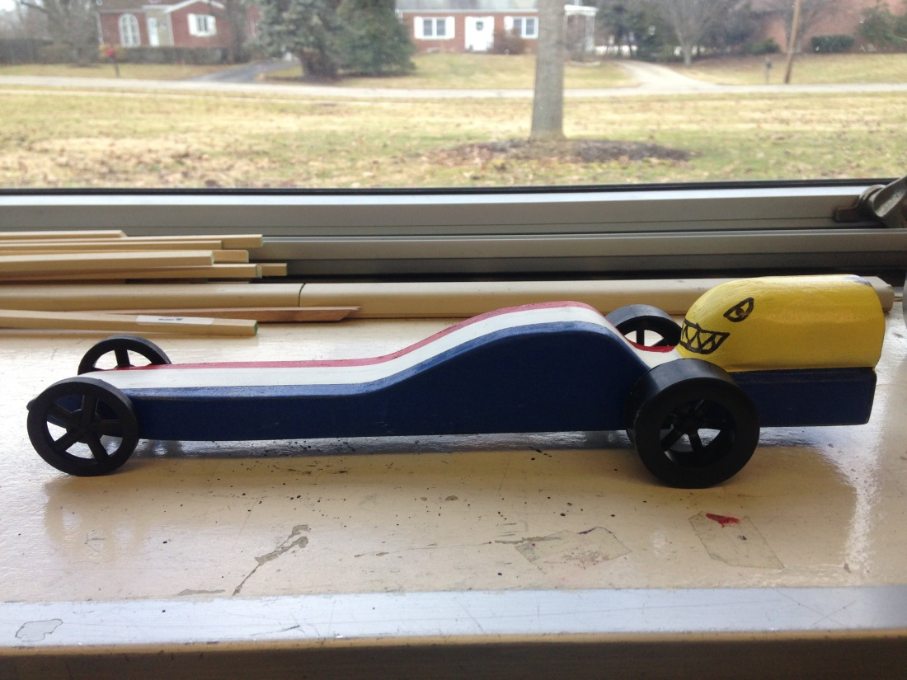
Our Dragster

Slide 3
Inventor Car Assembly

Slide 4
Inventor Car Presentation

Slide 5
Flow Design with wheels

Slide 6
Flow Design Without wheels

Slide 7
Blue Print Drawings

Slide 8
Drag Race!

Slide 9
Results
Trial | Time | Speed m/s | Speed km/hr | Speed (mph)
1 | 2.689 | 8.38 | 30.168 | 18.746
2 | 2.610 | 8.64 | 31.104 | 19.327
3 | 2.597 | 8.69 | 31.284 | 19.439
Average | 2.632 | 8.57 | 30.852 | 19.171

